Slide 1
Burn Down Chart
Pepper

Slide 2
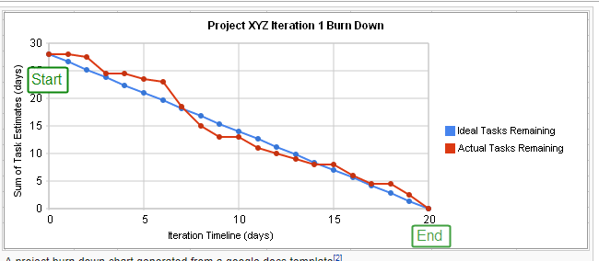
Purpose
When do I plan to finish?
Am I on track to finish?
Is every member of my team on track?
Should I replan early?
http://en.wikipedia.org/wiki/Burn_down_chart

Slide 3
Data for your release
List of person, story / task, planned effort days
Later add finished planned days (and maybe actual effort
project | story | task | person | start
my project | small maze | file | john | 4
my project | small maze | connect robot | jane | 3
my project | small maze | run | jane | 5
my project | end | light sense | john | 5
my project | end | report win | jane | 3
ideal - remaining effort |  |  |  | 20

Slide 4
Make chart and Graph
Set up all days you expect
Formula to show ideal diminishing planned days consumption
  Day before - total effort needed / total days you have
  Ex: =H7-$E$7/10
Set up one column per day
At stand up, fill in the effort remaining
Insert / chart / line graph
http://www.techbudha.com/2012/09/create-burn-down-chart-using-excel-in.html

Slide 5
Concepts
Man hours
Planned vs Actual vs Earned
Track at person / task level with groupings up to story level
Adjustments
  Drop tasks
  Adjust Acceptance Test Plan
Waterfall
  Gantt chart
  Critical Path

Slide 6
Better Templates
http://epf.eclipse.org/wikis/scrum/Scrum/guidances/templates/burndown_chart_D182CF23.html
Try Clay's template
  Scope change adjustments
  Entry in Burn Down and Release Burn Down

